Slide 2

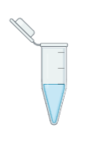
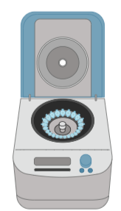
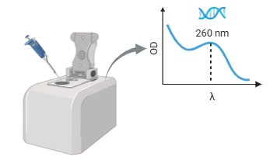
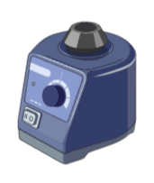
APEX2标记RNA反应
mixture 13uL
2mM BP 5uL
10 mM H₂O₂ 2uL
RNA 15uL
20uM APEX2 15uL
H₂O 9uL
2mM BA 5uL
10 mM H₂O₂ 2uL
mixture 13uL
H₂O 5uL
10 mM H₂O₂ 2uL
mixture 13uL
RNA纯化回收
Binding Buffer 13uL
无水乙醇 120uL
12000g 30s
Round1: Prep Buffer 400uL
Round2: Wash Buffer 700uL
水洗 1uL 擦拭
Blank 测基线 擦拭
上样 1uL Measure 擦拭
测得各组标记后的RNA浓度
Round3: Wash Buffer 400uL （清空后额外离心2min）
Round4: H₂O (65°C) 10uL （静置1min后离心2min）

Slide 3
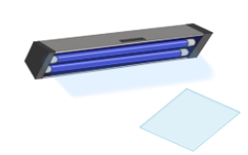
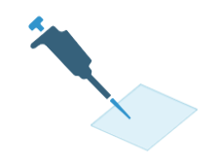

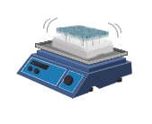


Dot Blot
紫外交联一次
稀释到同一浓度 347.65 ng.uL
等质量点样 3uL
PBS 洗
Round 0:
3% BSA 的 PBS 封闭30min
Round 1:
0.4 ug/mL SA-HRP 的 PBS 溶液
孵育 30min
Round 2:
PBST 溶液
洗三次
等体积加入发光液A和B 孵育1min

Slide 4
Biotin-Phenol
Biotin-Aniline
Without Probe
Biotin-Phenol

Slide 5
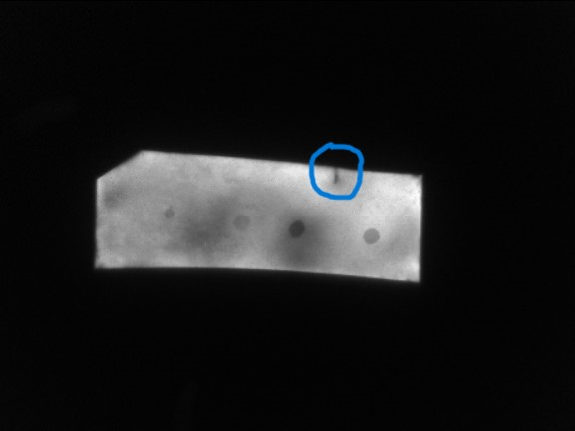
BP
BA
Without
Probe
BP

Slide 6
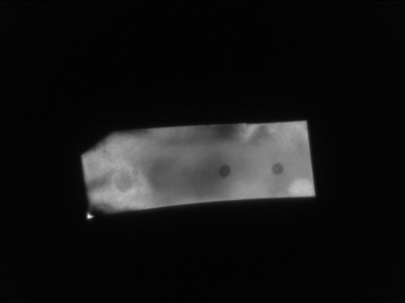
BP
BA
Without
Probe
BP
BP
BA
Without
Probe
BP

Slide 7
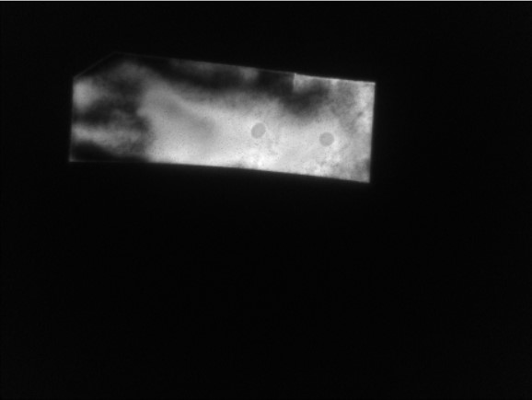
BP
BA
Without
Probe
BP

